Slide 1
3d-Printed Granular Jamming Hand
Melissa Indoe
Chris Kang
Sean Phelan
Maggie Serra
Chris Wallace

Slide 2
Project Background
About 12,500 new arm amputations happen in the US yearly
The vast majority, (77%) are due to trauma
Amputation is a global problem
It is estimated that only half of amputees ever get access to prosthetics
Existing myoelectric prosthetics start at $11,000
This cost is completely prohibitive to many people
The most common form of arm amputation is transradial
Incidence of about 44%
Loss of an arm can severely limit the independence of an amputee

Slide 3
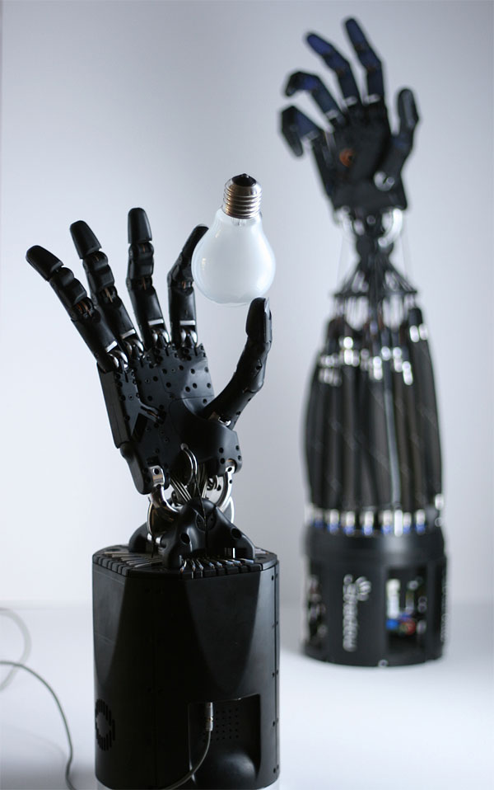
Project Objective
Create a “below-the-elbow” prosthetic hand
The hand should be:
open-source, making it available to anyone anywhere
highly affordable, making it inexpensive enough for anyone to use
high-functioning, giving its owner back their independence in many day-to-day activities
Task-oriented, focusing on dexterity rather than strength
Major issues involved:
Durability
Maintaining dexterity
Keeping costs low

Slide 4
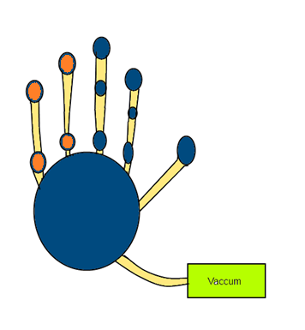
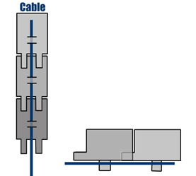
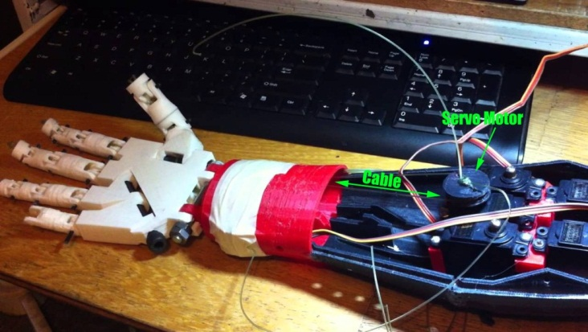
Recap: Phase 1 Conceptual Design
Primary hand design:
Run by 4 cables attached to motors in the forearm
Kept straight via flat springs or dental rubber bands
Grip will be sensed via encoders
Granular jamming pads will be made with stuffing beads or coffee
will be placed with 3 pads/finger on the most active parts of the hand, 2 pads/finger elsewhere
Printed in polycarbonate plastic or possibly ABS
Emulate the size and weight of an average human hand
Printed joint pins
Notes:
Primary hand design notes:
Run by 4 cables—initially it was to be run by 5 but this was simplified due to panel comments
Grip will be sensed via encoders—initially it was thought that the encoders would be necessary to maintain accuracy, this will be addressed later

Slide 5
Major Areas of Concern
Printed joint pins
Are they strong enough?
Are they within the abilities of an average 3D printer?
Rubber bands
Will they withstand the forces incurred by hand motion?
Can they withstand an appropriate number of bending cycles?
Material
Is ABS plastic strong enough for this application or is polycarbonate necessary?
Granular jamming pads
Is granular jamming helpful enough to justify?
Is there enough surface area for improved grip?
Can we achieve a vacuum in a reasonable timeframe?

Slide 6
Areas of Analysis
Analytical Analysis
Force analysis on rubber bands
Force analysis on a finger
Solidworks Analysis
Joint pin analysis
Physical Testing
Manufacturability testing and analysis
Granular jamming testing and analysis

Slide 7
1.a) Force analysis OF Rubber Bands

Slide 8
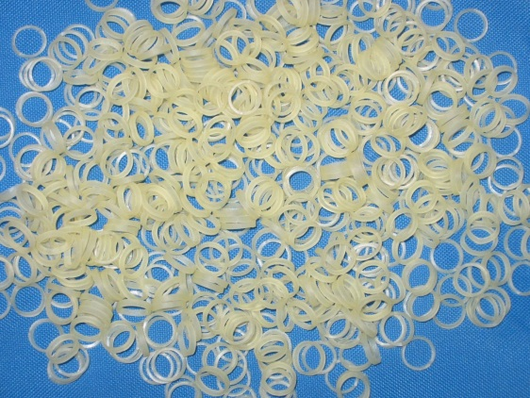
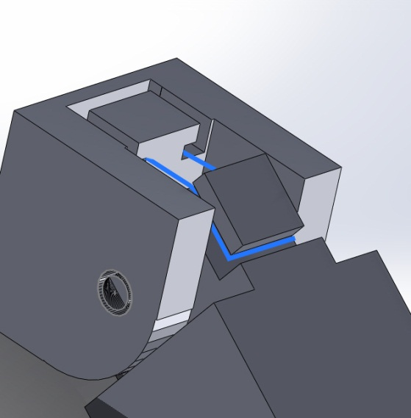
Rubber Bands—What needs to be analyzed?
Rubber bands are relatively fragile and prone to snapping
Points of failure:
Static load failure
Fatigue failure over bending cycles
If rubber bands fail this analysis, another finger-straightening method must be found

Slide 9
Rubber band analysis
Holding force:
τ_{max}=S_{y}/2 = 1MPa/2= 500,000 Mpa
Source: Berkeley Sensor & Actuator Center
τ_{actual}=F/(cross section)
F = force needed to stretch the rubber band 4mm
F=kx=(10 N/m)*(.004 m)
F=.04 N
τ_{actual}=F/(cross section)
=.04/(.001)² = 40,000 Pa
(well under maximum shear)
FOS=τ_{max}/τ_{actual}= 12.5
Notes:
This uses the max shear stress theory and defines failure as permanent deformation

Slide 10
Rubber band analysis
Number of cycles to failure:
S_{f} =aN^{b}
a=(f*S_{ult})²/S_{e}
b=(-1/3)log(f*S_{ult}/S_{e})
S_{ult}=15 MPa
S_{e}=S_{ult}*0.2 = (15 MPa)*0.2 = 3 MPa
a=(.8*15MPa)²/(3MPa)=48,000,000
b=(-1/3)log((.8*15MPa)/(3MPa))=-0.462
F=kx=10*(.012) = 0.12 N
S_{f} =F/(cross section) = 0.12/(.001)²
S_{f} = 120,000 N/m²
Sf= aN^{b}
120000 = 48000000*N^{-0.462}
N=4.29*10⁵ cycles
Notes:
Obviously though this doesn’t account for effects such as the defects on the rubber band surface or the stress concentration of being pulled into a rectangular shape but as a preliminary analysis it seems to show that these are going to last an appropriate amount of time with repeated finger bending.

Slide 11
1.b) Force analysis of a finger

Slide 12
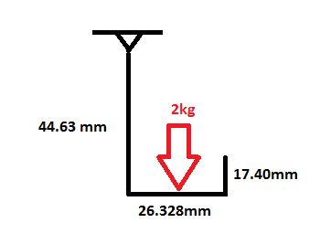
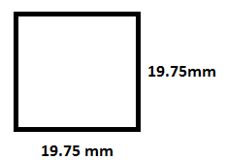
Force Analysis on a Finger
Assumptions:
The mass of the finger segments are negligible compared to the mass of the force
Square cross section

Slide 13
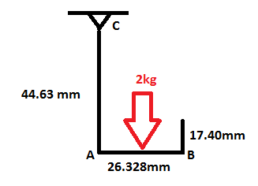
Calculations
Moment about A
M=Force x Distance
M=(2 kg*9.81 m/s²) x (0.026328 m/2)= 0.258 Nm
Bending Stress in AB
σ_{b}= My/I
I=b⁴/12 = (0.01975m)⁴ /12 = 1.27 x 10⁻⁸m⁴
σ_{b}= (0.258Nm)(0.01975m/2) / 1.27 x 10⁻⁸m⁴
σ_{b}= 200.3 kPa

Slide 14
Calculations
Max Shear Stress in AB
Ʈ=3F/2bh
Ʈ =[3(2kg*9.81m/s²) / 2(0.01975m)²] = 75.4 kPa
Normal Stress in AC
σ_{n}= F/A
σ_{n}= (2 kg*9.81 m/s²) / (0.01975m)² = 51.3 kPa

Slide 15
Maximum Stress
Maximum stress occurs in segment AC, on the inner side of the finger.
σ_{max} = σ_{b} + σ_{n}
σ_{max} = 200.3 kPa + 51.3 kPa
σ_{max} = 251.6 kPa

Slide 16
2.a) Joint Pin analysis

Slide 17
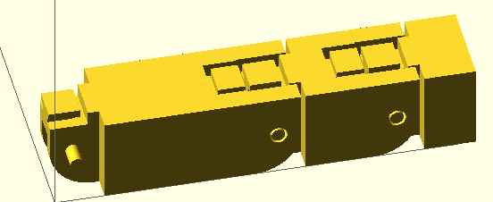
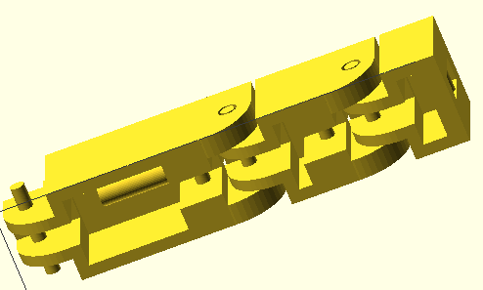
Model for Technical Analysis
A basic model was generated in OpenSCAD
This model included:
Finger segment lengths
Joint pin size
Hinge placement
Through examination, certain “common sense” design adjustments were made
It was decided at this point to use rubber bands rather than flat springs
This was because displacement at the joint interface was quite large
Notes:
As another “Common sense” adjustment, the encoders were eliminated because it was clear that the fingers would not need that level of percision

Slide 18
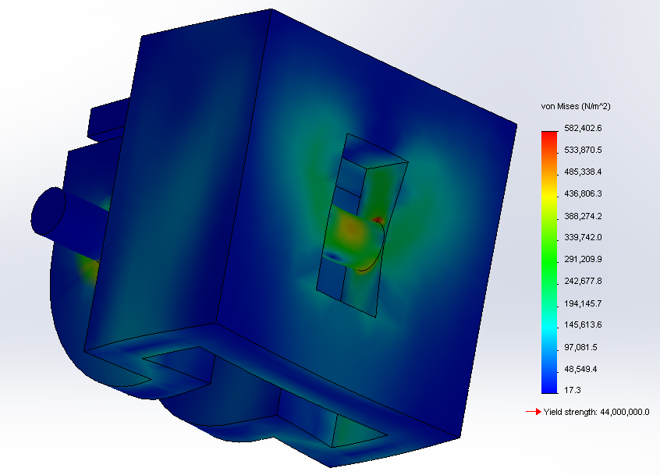
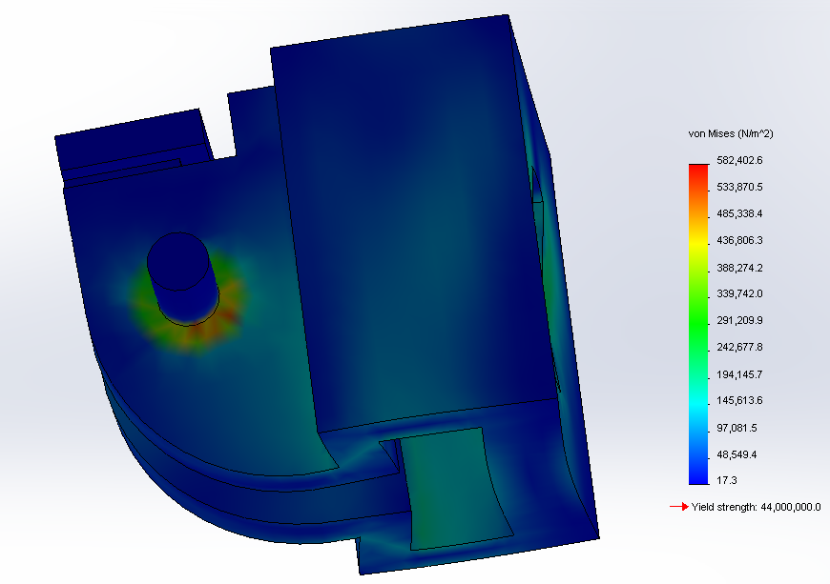
Technical Analysis—Joint Pin Stress
This model was then imported into Solidworks
Force studies were run on individual finger segments
Under standard working conditions, joint pin stresses never approached yield stress
Yield stress of ABS: 44 MPa
Maximum stress under working conditions: 13.8 MPa
Factor of Safety: 3.2
Analysis of “FingerTip” segment

Slide 19
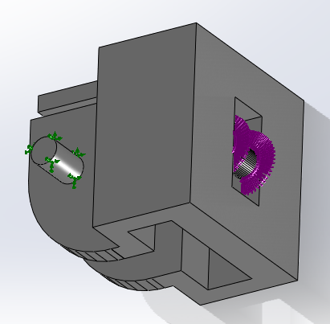
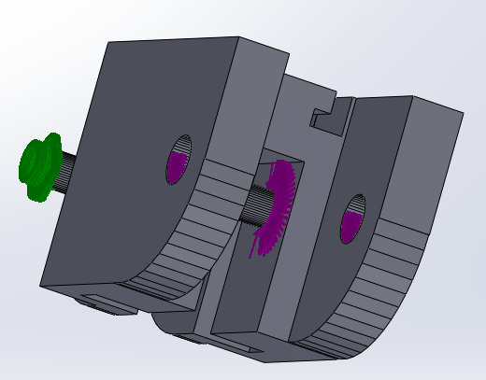
Terms of the Joint Pin Stress Analysis
Material: ABS plastic
Force: 4.5 N
The maximum force incurred by the selected servos
Fixed position: the joint pins
Pulling the wire inward grinds the joint pins against the hinge
Force application:
The point of connection at the fingertip
The joint holes and wire guides elsewhere
Diagram of force application (purple) and fixed position (green) of finger segments

Slide 20
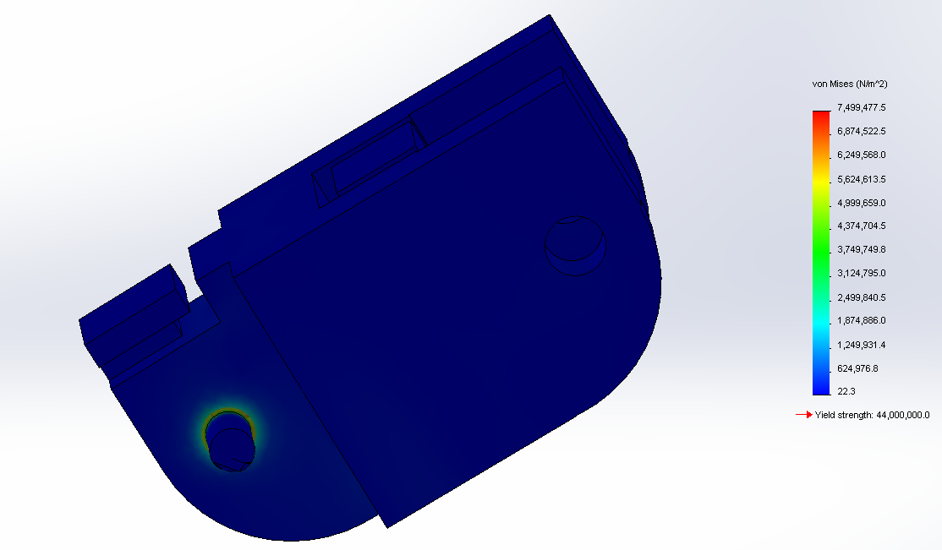
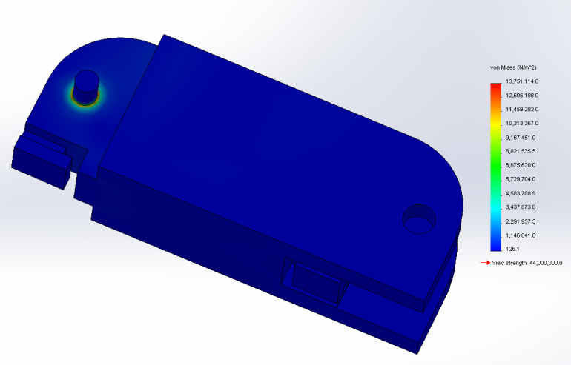

Joint Pin Stress Analysis (continued)
Top Left:
Analysis of “FingerMid” segment
Top Right:
Analysis of “FingerBase” segment
Bottom Left:
Detail of stress concentration at the joint pin interface

Slide 21
Joint Pin Analysis (Continued)
The joint pin analysis showed that ABS passed with flying colors
Therefore the idea of printing the project in polycarbonate plastic could be eliminated
Although polycarbonate is much stronger, it requires a specialized extruder to print correctly
It is also far more expensive than either ABS or PLA
This also suggested testing the joints with PLA plastic
PLA also passed these tests
Yield stress of PLA: 47.8 MPa
Maximum stress under working conditions: 13.8 Mpa
Factor of Safety: 3.5

Slide 22

Additional Solidworks Analysis
In an attempt to differentiate more between PLA and ABS plastics, a test of ultimate strength was done
Load to Failure test
Situation: Bending finger backward
Bending it forward would only push it into the palm, which would protect it from damage
Examines joint pins at the base of the finger
Two tests were run
Worst case scenario: all force is transferred to joint pins
Realistic scenario: force is transmitted to joint pins and
top edge

Slide 23
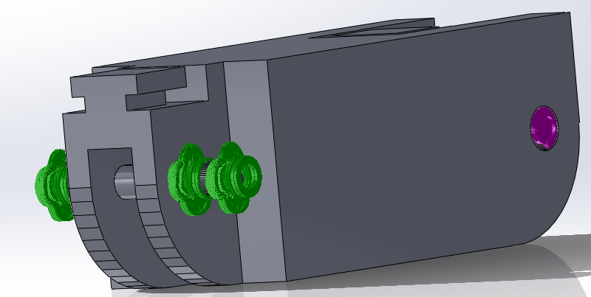
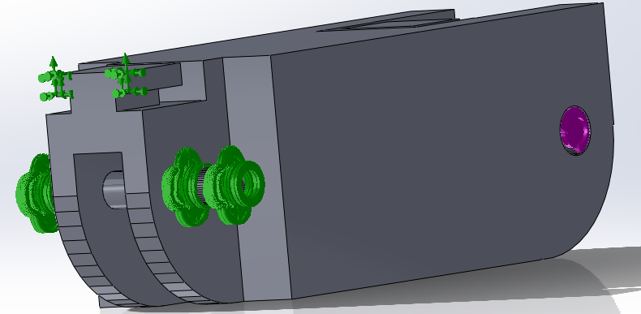
Terms of Load to Failure
Force application:
Through the joint pin holes (up and back)
Definition of “Failure”
Applied stress is greater than yield strength
Two tests were run for each material
“Worst case scenario”—force is only applied to joint pins
“Realistic scenario”—joint pins elastically deform and the top edges make contact with other hinge
Worst case (top) and realistic case (bottom) diagrams of force application (purple) and fixed position (green)
Notes:
“Applied stress is greater than yield strength” was chosen because if the joint pins are bent, then they are useless (they don’t just have to be sheared off)
Pins were analyzed at base only because base incurs the largest stress due to the fact that it has the whole finger acting as a moment arm

Slide 24
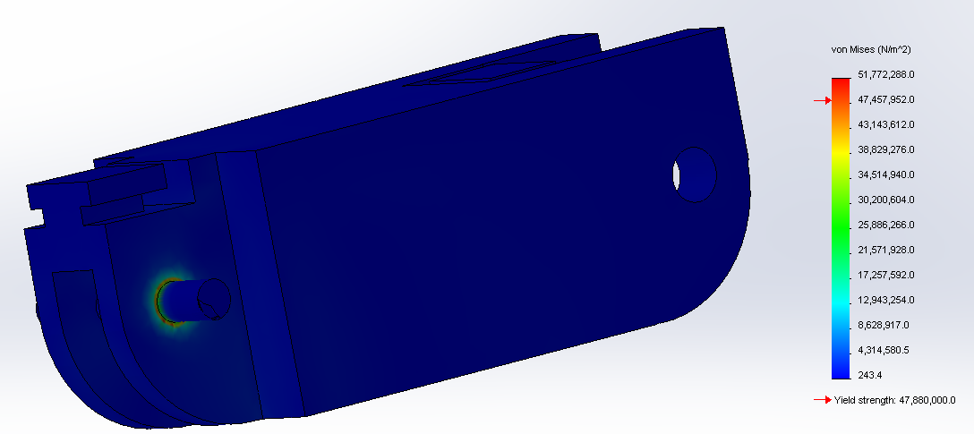
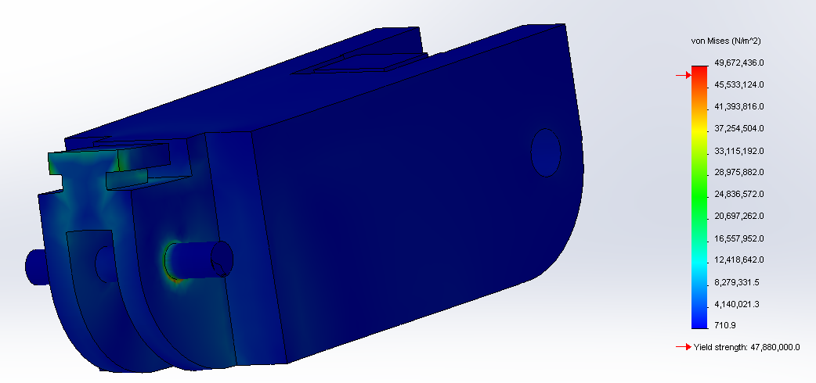
Solidworks Load to Failure
In worst case scenario, both materials failed at just under 15 N
In realistic scenario, ABS failed at ~40 N, and PLA failed at ~43 N
In this test, both materials are comparable
Conclusion: Both materials are passable, but ABS may be better (due to superior impact resistance)
Worst case (left) and realistic (right) loading scenarios.

Slide 25
3.a) Manufacturability testing and analysis

Slide 26
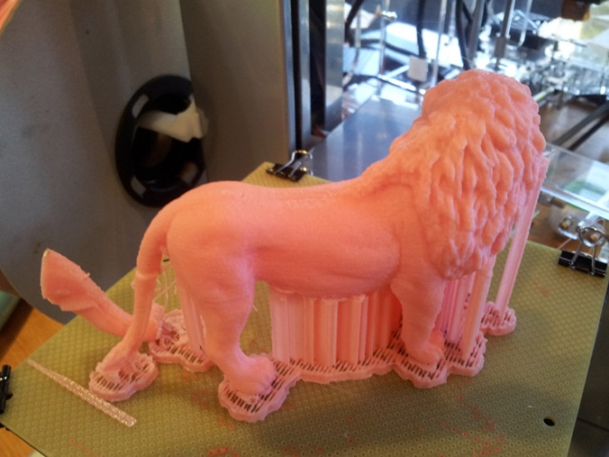
Manufacturability
This design is meant to be printed as a non-assembly model
Requires floating joint pins
Printing floating geometry is extremely problematic
Printer is extruding filament in midair with no support—anything manufactured this way will be warped
It is necessary to see if the warping of the joint pins is acceptable
If not, another design must be found
One other aspect—proper clearances
If clearance is too low joints will fuse
Two necessary aspects of joints:
Must have enough clearance to print
Must not have so much that joint is unstable
Notes:
Lion is an example of one way that 3d printers can accurately print floating geometry, the strings are support material meant to be cleaned off. The clearances inside the joints however are too small to clean out.

Slide 27
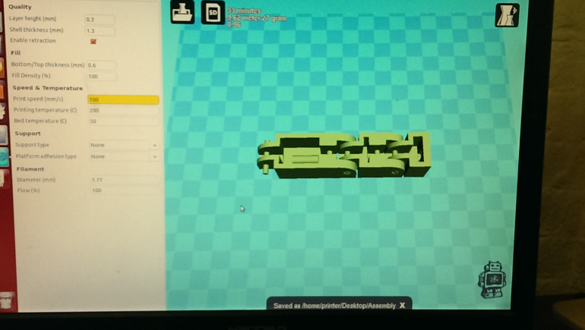
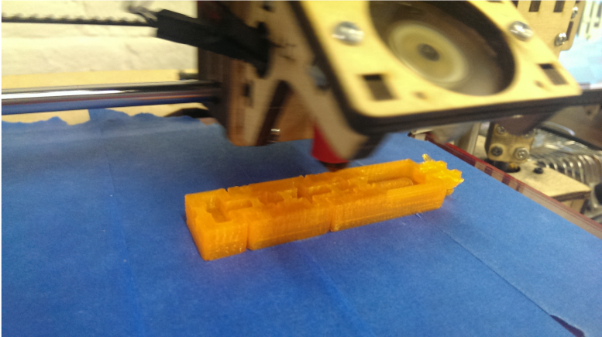
Manufacturability
To test manufacturability of the finger, a test print of the model was performed
This print weighed 27 grams (well within limits for a human finger)
It cost about 84 cents in material
It took only 30 minutes to create (well within reasonable time constraint for prosthetic manufacture)
Model display in the Repetier software (left) and model in the process of printing (right)
Notes:
Part of the draw of 3D printing is that material is extremely cheap and readily accessible-- This means that a project like this can be printed at an early stage, dealing with many manufacturing issues early on

Slide 28
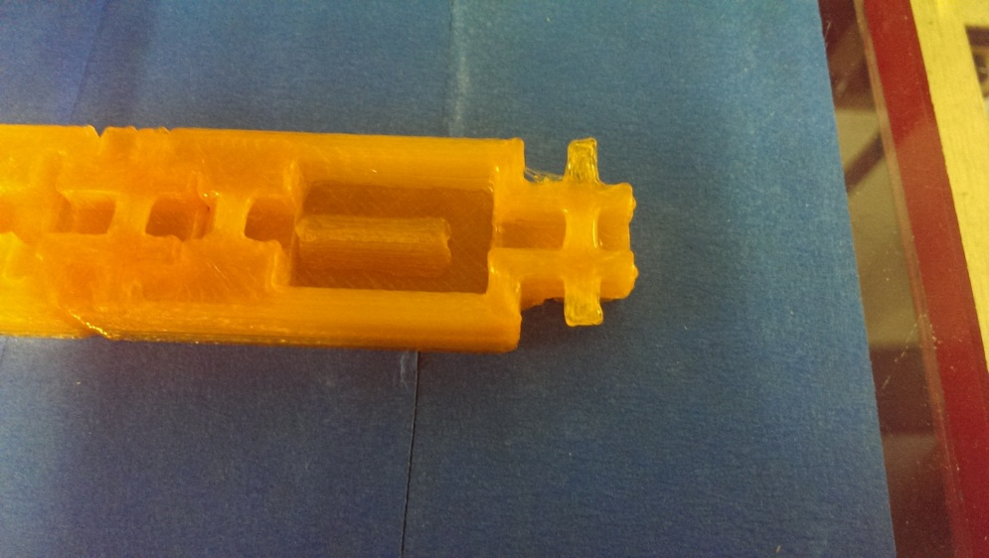
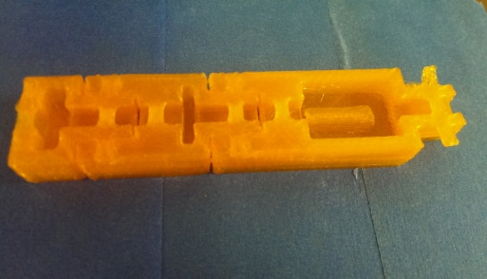
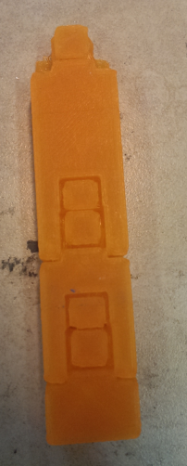
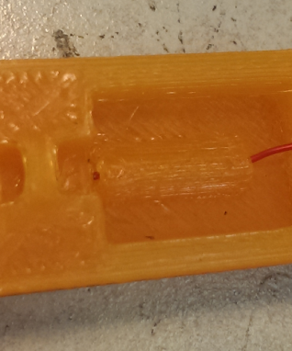
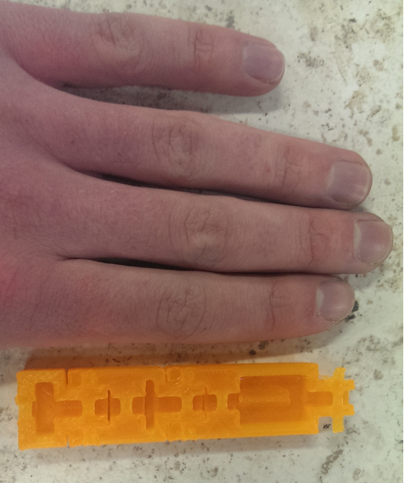
Manufacturability
Points of failure were identified
Hinge tolerances were too small
Hinges were fused
Joint pins were too warped for the design to function
Positive points were also identified
Rubber band guide overhangs printed successfully
Wire guide functioned with no issues
Scaling was perfect
Joint pins (left) are definitely too rough for a plastic-on-plastic joint interface. Joint tolerance (right) is too low, plastic has bridged the points of articulation and the finger is solid.
The scaling (left), rubber band guides (center) and wire guides (right) are all correct and functional.
Notes:
Tolerance was set to .5, well above the .04 mm that 3d printers should be capable of, but of course real life often isn’t like simulations.
To be fair part of this is the quality of the plastic here. This plastic was extruded at too high a temperature, which accounts for a lot of the “goopy” appearance (as well as some of the slop in the dimensions)

Slide 29
Manufacturability—What does it mean?
Based on these findings it should be completely reasonable to use 3D printing as the method of manufacture
It is more than possible to achieve the necessary detail at the needed scale (with some modification)
Modifications required:
Larger joint clearances
Avoid joint pin on plastic contact

Slide 30
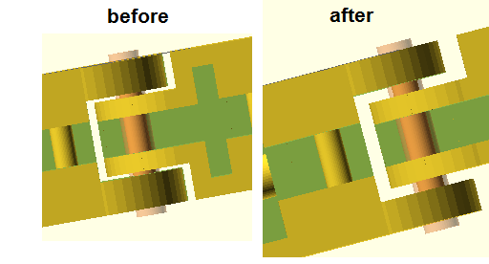
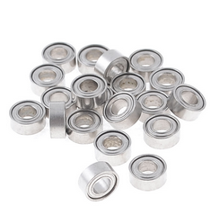
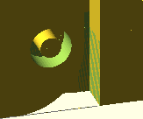
Manufacturability—Solution
Joint clearance was greatly increased
Bearings were introduced in order to solve the problem of warped joint pins
The plastics involved are very pliable (especially when hot)
Applying a heat gun and then press-fitting a bearing into the joint will solve all friction issues
A clearance the size of a bearing (2mm) between parts will never bridge or fuse
Left to right: Improved joint clearances, bearings, bearing clearance.

Slide 31
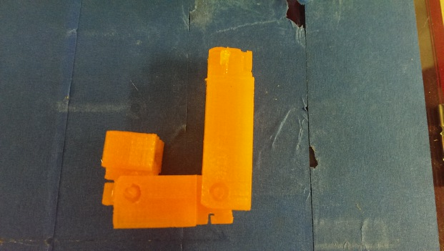
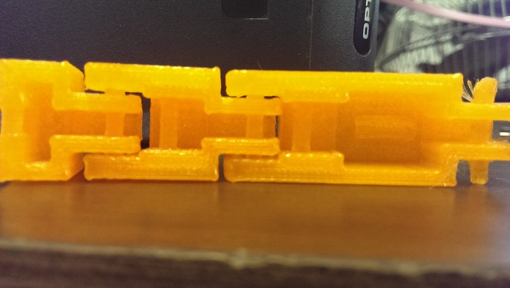
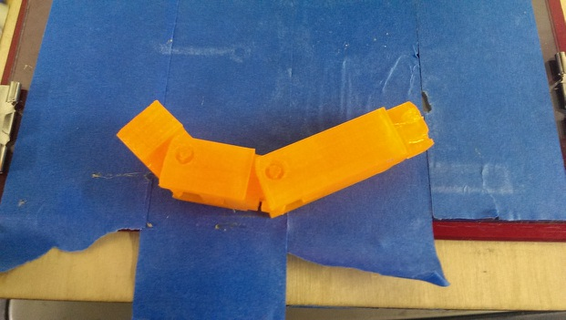
Manufacturability—Solution
Making these changes fixed the manufacturing issues
It is now safe to say that the basic design is viable and it will be possible to manufacture an articulated model in one piece

Slide 32
3.b) Granular jamming analysis

Slide 33
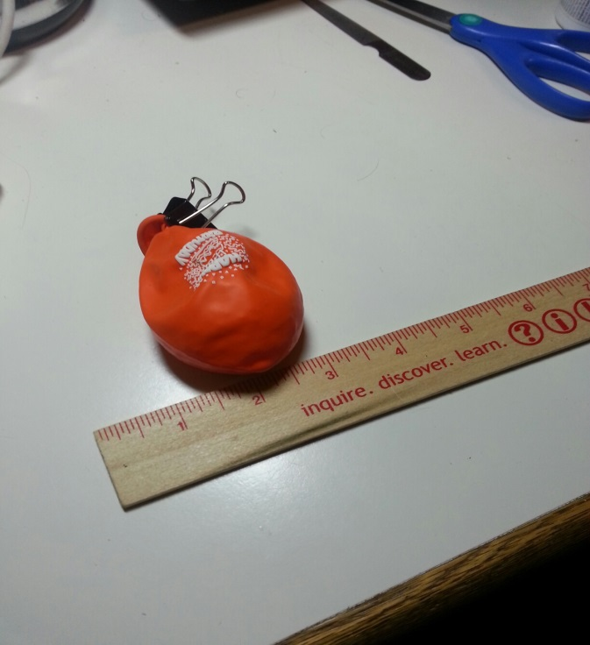
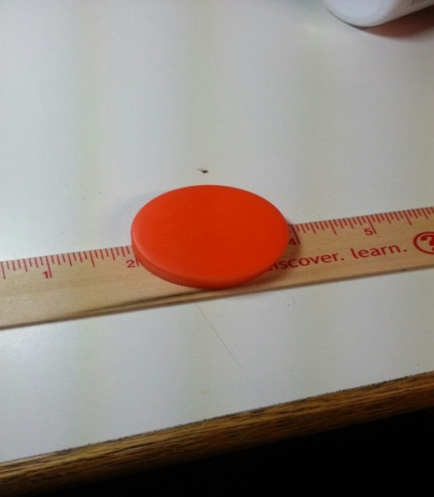
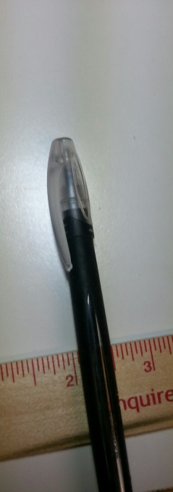
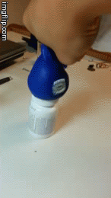
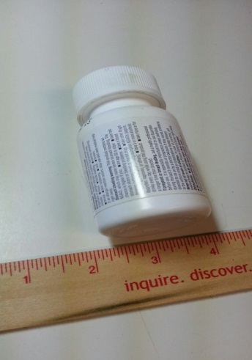
Granular Jamming Testing

Slide 34
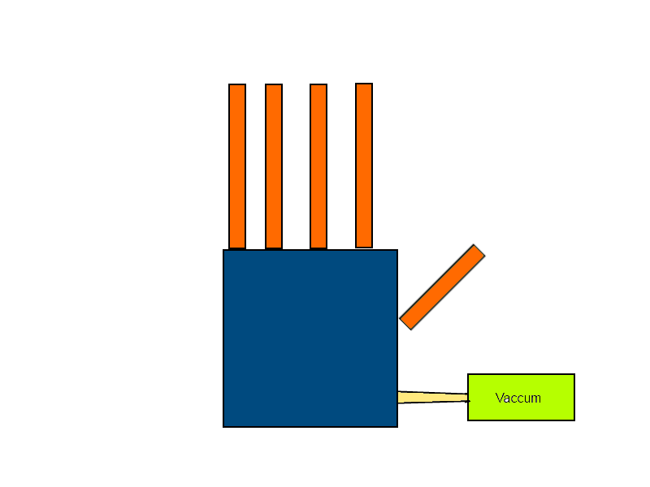

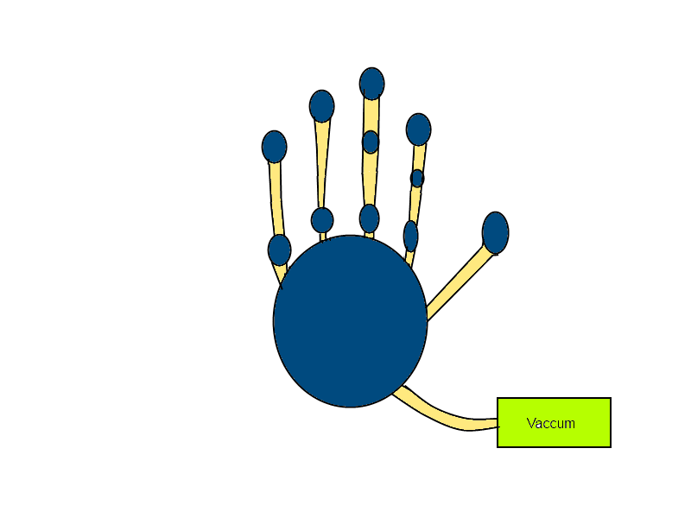
New Proposed Design
Coffee grounds proved to be far more effective than plastic stuffing material in tests
Therefore coffee grounds are the new proposed material
Old Design
New Design

Slide 35
Calculations
Force on object
Assuming object to be held is 1 lb (0.453 kg)
ΔP= 75kPa
F=P*A
0.453kg=75000Pa*(πr²),
Diameter=8.7mm - 10mm standard tubing will be used
Evacuation time
q = 3.659*10⁻⁵ m³/s
V = 3.659*10⁻⁵ m³
P₀ =1013.25 mbar
P₁ = 266.25 mbar
t = V/q * ln (P₀/P₁)
t = 0.652 seconds

Slide 36
Addressing Major Areas of Concern
Printed joint pins
Are they strong enough? YES
Are they within the abilities of an average 3D printer? Yes, with bearings
Rubber bands
Will they withstand the forces incurred by hand motion? YES
Can they withstand an appropriate number of bending cycles? YES
Material
Is ABS plastic strong enough for this application or is polycarbonate necessary? ABS is fine, PLA is also suitable
Granular jamming pads
Is granular jamming helpful enough to justify? Yes, it can lift many items
Is there enough surface area for improved grip? Yes, in the palm
Can we achieve a vacuum in a reasonable timeframe? YES

Slide 37
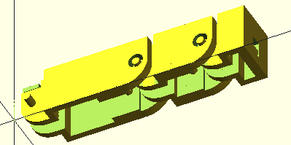
Review: Phase 2 Conceptual Design
Primary hand design:
Run by 4 cables attached to motors in the forearm
Kept straight via dental rubber bands
Grip will be sensed via servos
Granular jamming pads will be placed on the palm only
Printed in ABS
Emulate the size and weight of an average human hand
Printed joint pins (with bearings)

